Slide 1
2023/09/27
F06 RUN G33 STEP.5 gas interlock abort

Slide 2
Discipline 1. 選定團隊 Form the Team
團隊負責人Team Leader/Dept.:
成員Team Member/Dept.:
Name | Department | Position
薛鐘隆 | S220 | FAB2
黃世杰 | S210 | FAB2
黃建華 | S220 | FAB2

Slide 3
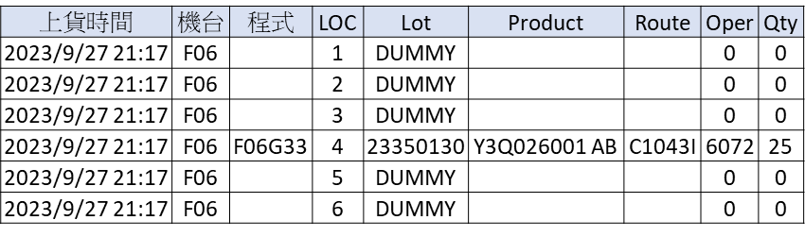
Discipline 2.描述問題及現況掌握Describe the Problem
(WHO detected the problem? WHAT is wrong? State the problem in terms of object and defect. WHERE the problem was first detected, describe location of the detection, lot #, WHEN and HOW it was detected)
What | 20230927 F06 RUN G33 STEP.5 剩00:11:58時gas interlock abort
Where | Oper.6072
When | 2023/09/27
Extent | 1 lot/ 25 pcs

Slide 4
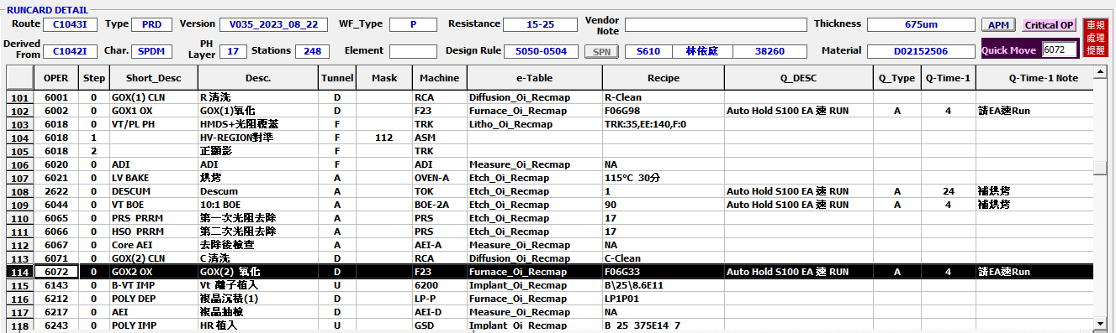
Discipline 2.描述問題及現況掌握Describe the Problem
lot History - 調查過程簡述 (Investigation):
將有問題的站點前後 run cards 貼上
Issue 前站點：6071
Issue 站點 ：6072
Issue 後站點：6143

Slide 5
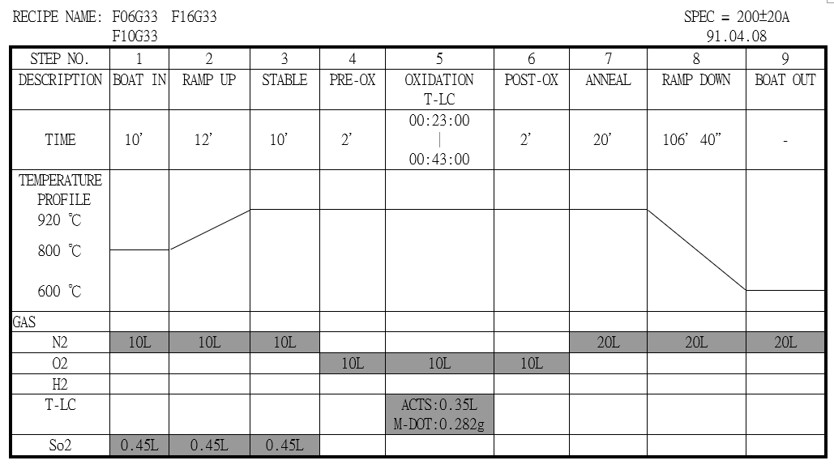
Discipline 2.描述問題及現況掌握Describe the Problem
(WHO detected the problem? WHAT is wrong? State the problem in terms of object and defect. WHERE the problem was first detected, describe location of the detection, lot #, WHEN and HOW it was detected)
Run G33 step.5 GAS I/L abort, step.5 剩餘 00:11:58(step.5 total time:00:34:45)

Slide 6
Discipline 2.描述問題及現況掌握Describe the Problem
lot History - 調查過程簡述 (Investigation):
RMS check
Check temp : Step.5 TEMP 正常，於 STEP.5 剩 11 分鐘 58 秒 GAS interlock ABORT。
設定溫度
實際溫度

Slide 7
Discipline 2.描述問題及現況掌握Describe the Problem
lot History - 調查過程簡述 (Investigation):
設定值
實際值
Check GAS flow :
O2
T-LC
O2
T-LC
Step.5 O2 & Tr-LC 流量正常。

Slide 8
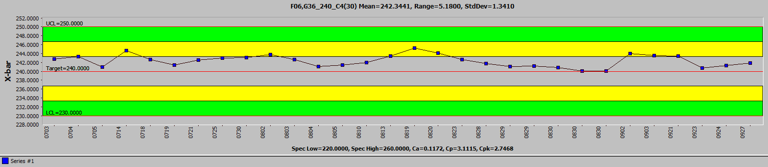
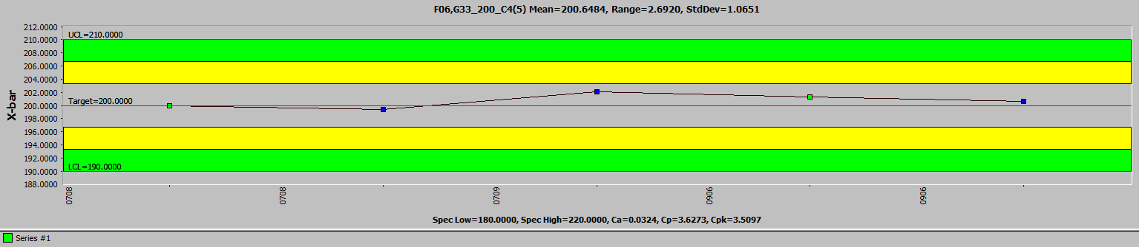
EDC & RTC
Discipline 2.描述問題及現況掌握Describe the Problem
lot History - 調查過程簡述 (Investigation):
前一個 RUN G36_C4_240 厚度正常。
異常 RUN G33 之前 RTC皆正常。

Slide 9
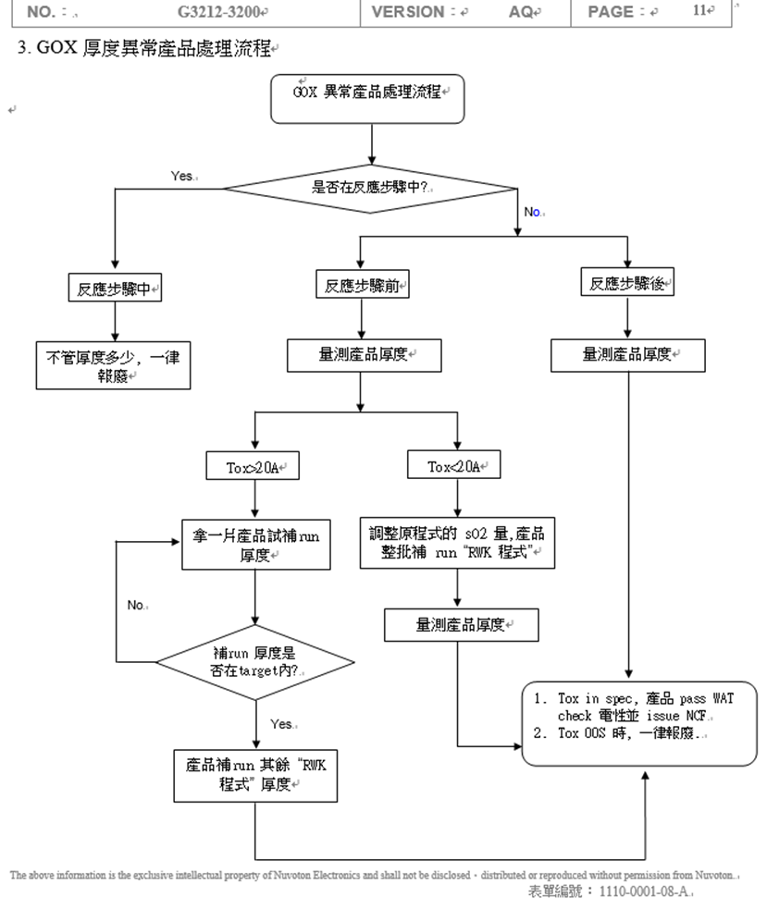
OCAP
Discipline 2.描述問題及現況掌握Describe the Problem
lot History - 調查過程簡述 (Investigation):
貼出此異常事件的 OCAP 處理流程圖, 依此流程所下之決定為 TOX O.O.S. 時一律報廢。
(OI 在 S210 網頁有 word file)

Slide 10
Discipline 2.描述問題及現況掌握Describe the Problem
Is/Is Not table (釐清問題):
 |  | Is | Is Not | Difference/Conclusion
What | object | GOX | Others | NA
 | Defect | GOX TOX OOS | GOX TOX normal | TOX：125.7 O.O.S. ( Spec：200+/-20A )
Where | Location | 6072 operation | 6072 operation | NA
 | Machine | F06 | F16/F18/F19/F23 | F06
When | First time | 2023/9/27 | Not before | 2023/9/27
 | Reoccurred | 2023/9/27(持續/重複發生時間點) | Never before 2023/9/27 (未發生時間點) | 2023/9/27
How | Many | 1 LOTS | NA | 1 LOTS
 | Trend | GOX TOX lower | GOX TOX normal | GOX TOX lower

Slide 11
Discipline 3.執行及驗證暫時防堵對策 Contain the Problem
(Define and implement containment actions to isolate the effect of problem from any internal/external customer until corrective action is implemented)
3.1 異常產品 (Defect Lots)
項目 Item | 處理方式 Action | 負責人員 Resp | 預定完成日 Due | 實際完成日 Imp. | 處理結果 Verification
23350130/C1043I | 反應步驟中ABORT 報廢 | 黃世杰 | 9/28/2023 | 9/28/2023 | 23350130 全批報廢
3.2 波及產品 (Impact Lots)
項目 Item | 處理方式 Action | 負責人員 Resp | 預定完成日 Due | 實際完成日 Imp. | 處理結果 Verification
NA | NA | NA | NA | NA | NA

Slide 12
Discipline 3.執行及驗證暫時防堵對策 Contain the Problem
(Define and implement containment actions to isolate the effect of problem from any internal/external customer until corrective action is implemented)
3.3 波及設備 (Impact Machine)
項目 Item | 處理方式 Action | 負責人員 Resp | 預定完成日 Due | 實際完成日 Imp. | 處理結果 Verification
F06 | 停機檢查 | 蔡孟哲 | 2023/09/28 | 2023/09/28 | Replace B/E driver
3.4 波及製程 (Impact Route) : 是(YES)/否(No)
項目 Item | 處理方式 Action | 負責人員 Resp | 預定完成日 Due | 實際完成日 Imp. | 處理結果 Verification
No | No | No | No | No | No
3.5 產品召回選項，是否需進行客戶端波及產品的召回?是(YES)/否(No)
Customer | Product No. | Lot number / Wafer number | Approx. Quantity
No | No | No | No

Slide 13
Discipline 4.定義及驗證真因 (Identify the Root Cause)
(Identify all potential causes which could explain why the problem occurred)
4.1 Non-conformance root cause (defect nature / technical root cause):
a) Failure mechanism:
Run G33 recipe
Step.5 反應步驟中剩餘 00:11:58 (step.5 total time:00:34:45)，Gas Interlock abort 造成 Thickness 125.7 ( Spec：200+/-20A ) O.O.S. 。

Slide 14
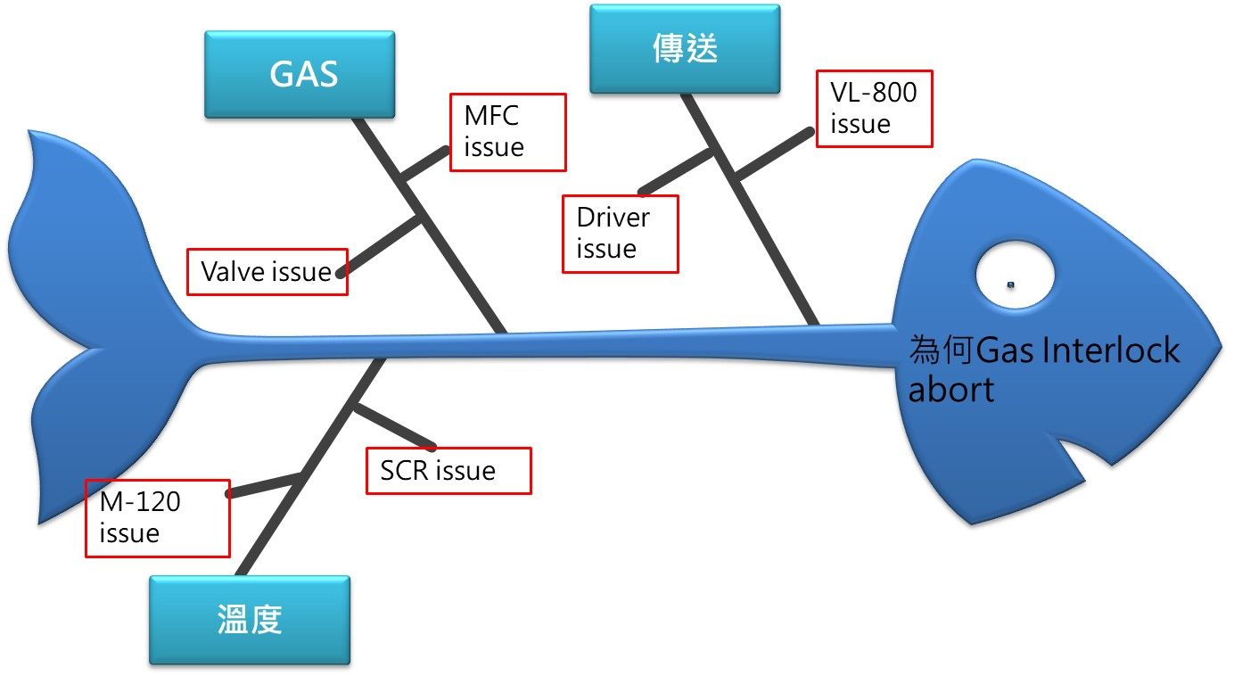
Discipline 4.定義及驗證真因 (Identify the Root Cause)
(Identify all potential causes which could explain why the problem occurred)
4.1 Non-conformance root cause (defect nature / technical root cause):
b) 列出所有可能的原因 (Probable Causes/Factors): Non-conformance
工具 (Tools): 故障樹分析 (Fault Tree Analysis)、魚骨圖 (Fishbone)

Slide 15
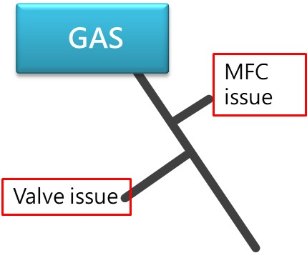
Discipline 4.定義及驗證真因 (Identify the Root Cause)
(Identify all potential causes which could explain why the problem occurred)
4.1 Non-conformance root cause (defect nature / technical root cause):
c) 真因驗證 (Root Cause Verification)
GAS
機台程式步驟4~5 未alarm，氣體流量設定與實際無差異。
當程式步驟通 H2+O2 / Trans-LC 時，若 cap 未在 P04 位置時會 Gas interlock alarm，機台啟動安全保護機制會將 H2 & Trans-LC valve close。

Slide 16
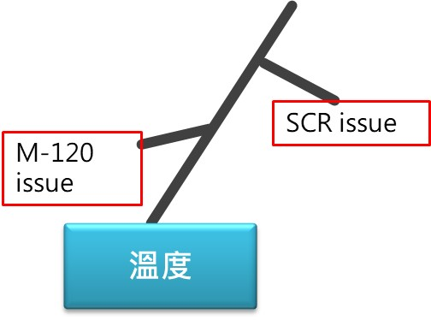
Discipline 4.定義及驗證真因 (Identify the Root Cause)
(Identify all potential causes which could explain why the problem occurred)
4.1 Non-conformance root cause (defect nature / technical root cause):
c) 真因驗證 (Root Cause Verification)
溫度
溫度與設定無差異
Power 輸出正常，無 100% 輸出。

Slide 17
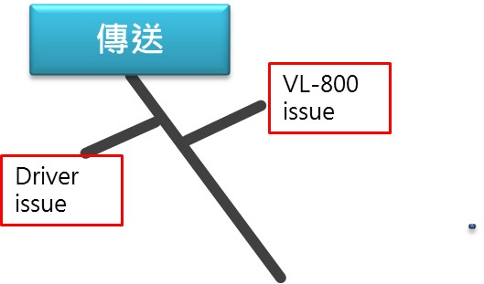
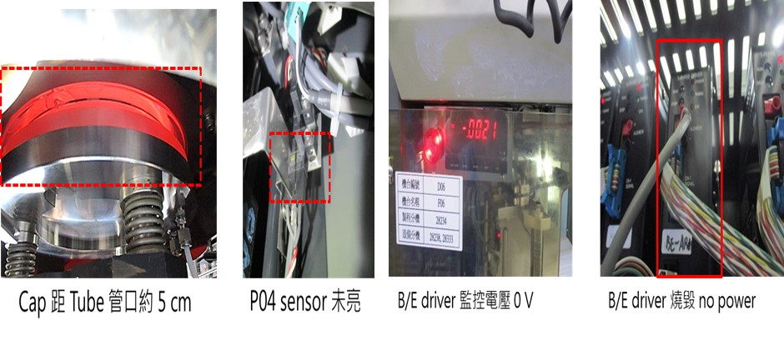
Discipline 4.定義及驗證真因 (Identify the Root Cause)
(Identify all potential causes which could explain why the problem occurred)
4.1 Non-conformance root cause (defect nature / technical root cause):
c) 真因驗證 (Root Cause Verification)
傳送
B/L cap 未在 P04 位置，下降至距 Tube 管口約 5 cm。
VL-800 ID.01 alarm，B/E driver 電壓 0V。
驗證
將 F32 機台 B/E driver 電源關閉，模擬 B/E driver no power 後 cap 同樣下降約 5 cm。
確認 B/E driver no power 後 cap 因無煞車制動力會下降約 5 cm。

Slide 18
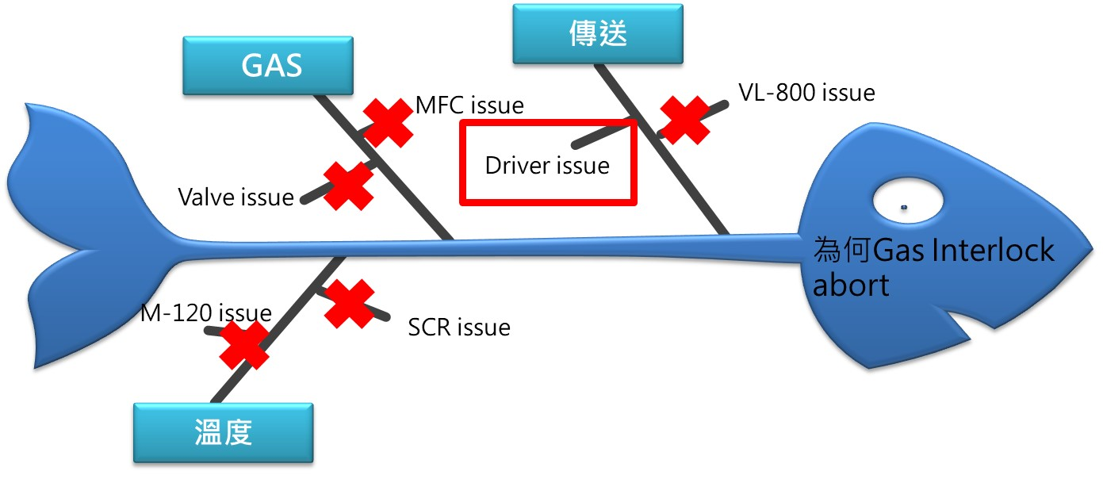
Discipline 4.定義及驗證真因 (Identify the Root Cause)
(Identify all potential causes which could explain why the problem occurred)
4.1 Non-conformance root cause (defect nature / technical root cause):
c) 真因驗證 (Root Cause Verification)
真因 : Driver 無電力輸出
零件燒毀，造成煞車失效 Elevator 位置下滑，觸發安全 interlock 作動導致程式中
斷厚度異常。

Slide 19
Discipline 4.定義及驗證真因 (Identify the Root Cause)
(Identify all potential causes which could explain why the problem occurred)
4.1 Non-conformance root cause (defect nature / technical root cause):
d) 5-Why analysis
為什麼產品厚度會OOS ?
因為反應步驟未完成即 abort
為什麼反應步驟未完成即 abort ?
因為機台偵測到 Boat elevator 未在 P04 正確位置
為什麼Boat elevator 未在 P04 正確位置?
因為煞車失效造成下滑
為什麼煞車失效下滑?
因為 driver 電壓輸出異常
為什麼 Driver 電壓輸出異常?
因為 Driver PCB 零件損毀
b) Conclusion :
更換Driver

Slide 20
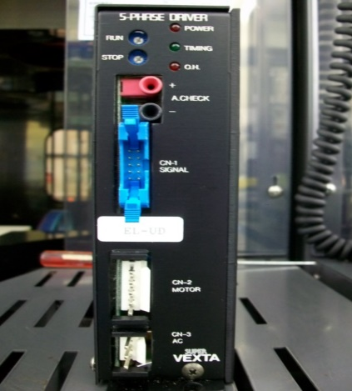
Discipline 4.定義及驗證真因 (Identify the Root Cause)
(Identify all potential causes which could explain why the problem occurred)
4.2 Non-detection / escape root cause (Provide reason to why the current system failed to detect)
a) 5-why:
為何Driver 輸出電壓異常無法預防
針對 B/E 行進中/靜止中加裝 driver 輸出電壓監控，當電壓低於設定會有警示alarm 可經調整達到設定值。
若在生產過程中,發生電壓輸出異常 0V，會造成煞車失效 Elevator 位置下，
造成 Sensor 作動+氫氣供給中斷，因屬重要製程無法 RWK。
b) Conclusion
定期更換 DRIVER

Slide 21
Discipline 5.擬定及驗證永久改善對策Choose and verify permanent corrective action (列出各項執行之對策並檢核其對策有效性)
5.1 What was the chosen corrective action to correct the root cause? (Add photo or diagram where applicable.)
將 F06 B/E Driver 更換
訂定 GOX 機組更換週期
每兩年定期更換維修後之 B/E driver，可提前預防逐漸衰退之 driver 無預警瞬間
燒毀。

Slide 22
Discipline 5.擬定及驗證永久改善對策Choose and verify permanent corrective action (列出各項執行之對策並檢核其對策有效性)
5.2 Verification of actions effectiveness
F06 更換 Driver 至今無發生異常
GOX 機組全面更換 Driver (F16/F18/F19/F23)

Slide 23
Discipline 6.實施確認永久改善對策Corrective Actions Implementation
6.1 For non-conformance root cause (defect nature / technical root cause):
Nbr. | Actions | Who | When | Remarks / Evidence (Document/Spec/Chart #)
F06 | Replace B/E driver | S220 蔡孟哲 | 2023/09/27 | Run/Stop: 0.40 V / 0.20V
6.2 For non-detection / escape root cause
Nbr. | Actions | Who | When | Remarks / Evidence (Document/Spec/Chart #)
GOX | 更換 B/E driver & 確認輸出電壓 | S220 薛鐘隆 | 2024/01/20 | Spec ( Run/Stop:0.38+-0.04/0.18+-0.02 )

Slide 24
Discipline 6.實施認永久改善對策Corrective Actions Implementation
FMEA new item:
Item | Potential Failure Mode | Potential Effect(s) of Failure | S. E. V. | C L A S S. | Potential cause(s) / mechanism(s) of Failure | O. C. C. | Current Process Control Prevention | Current Process Controls Detection | D. E. T. | R. P. N. | Recommended Action | Responsibility & Target Completion Date | Action Results
Process, Function, Requirements |  |  |  |  |  |  |  |  |  |  |  |  | Actions Taken | S. E. V. | O. C. C. | D. E. T. | R. P. N.
Gate oxide | M/W Tox：125.7 Spec：200+/-20A | 依照 OCAP 處理流程無法 rework SCRAP single lot in-line | 5 |  | B/E driver 燒毀 Cap 未在 P04 正確位置時會 Gas interlock， H2 / O2 / Trans-LC Valve 會 close 停止通 Gas | 2 | 加裝 B/E driver run / stop voltage 監控電錶alarm 機制 | EDC | 2 | 20 | 每兩年定期更換維修後之 B/E driver，可提前預防逐漸衰退之 driver 無預警瞬間燒毀。 | S200 2024/01/05 | Replace B/E driver | 5 | 1 | 2 | 10

Slide 25
Discipline 7.避免再發Prevent Recurrence (Modify System / Document)
7.1 Systemic Actions:
Factor | Actions | Who | When | Remarks / Evidence (Document/Spec/Chart #)
Practices/ Training | Driver 外送維修 | S220 | 2023/11/15
Work Instruction | GOX機組 B/E driver更換 | S220 | 2024/01/05 | GOX 機台 APM 時平行展開
Specification | 確認 B/E driver run / stop voltage 電壓是否正常 | S220 | 2024/01/05 | Spec ( Run/Stop:0.38±0.04/0.18±0.02 )
Control Plan | PM 時檢查輸出電壓 | S220 | YPM | Spec ( Run/Stop:0.38±0.04/0.18±0.02 ) O.I. ：G3363-1010
* FMEA (must) | 定期更換 B/E driver | S220 | 兩年 | EMS parts PM 提醒設定
Error Proofing | N/A | N/A | N/A | N/A

Slide 26
Discipline 7.避免再發Prevent Recurrence (Modify System / Document)
7.2 Corrective Actions Fan-out: (水平展開):
Machine/ Process/ Product | Actions | Responsible | Due date
F06 F16 F18 F19 F23 | 更換 B/E driver 及確認 run / stop voltage 皆大於 0.38 (V) / 0.18(V) | S220 | F06 - 09/27/2023 done F16 - 01/05/2024 done F18 - 01/05/2024 done F19 - 01/05/2024 done F23 - 01/05/2024 done
Machine | Run ( vdc ) | Stop ( vdc )
F06 | 0.40 | 0.20
F16 | 0.39 | 0.19
F18 | 0.40 | 0.19
F19 | 0.38 | 0.18
F23 | 0.39 | 0.20

Slide 27
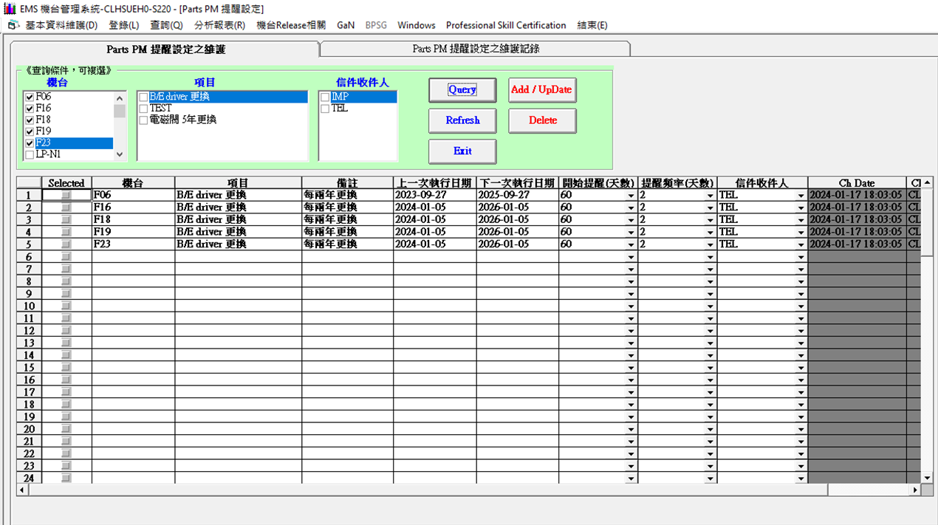
Discipline 7.避免再發Prevent Recurrence (Modify System / Document)
7.2 Corrective Actions Fan-out: (水平展開):
EMS parts PM 提醒設定每兩年定期更換 B/E driver

Slide 28
Discipline 8. Congratulate the Team
Thanks for every member helped in this case.
Reviewed and Approved by:
Name | 2. Position | 3. Date
S210 陳永昌 | SECTION MANAGER | 2024/01/26
S220 邱尊護 | SECTION MANAGER | 2024/01/26
S200 李明驥 | DEPARTMENT MANAGER | 2024/01/26

